Slide 1
3D Web Maps
Simulate a three dimensional scene
There is a camera (i.e. View) that can be moved through the scene
Objects are placed in the scene
Lights make the objects visible
The interactions between objects and lights can make the objects appear more or less real

Slide 2
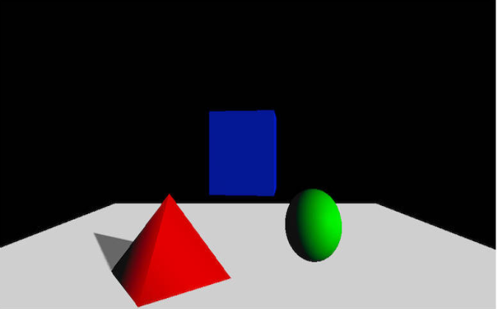
Historical Context
https://developer.ibm.com/tutorials/wa-webgl3/

Slide 3
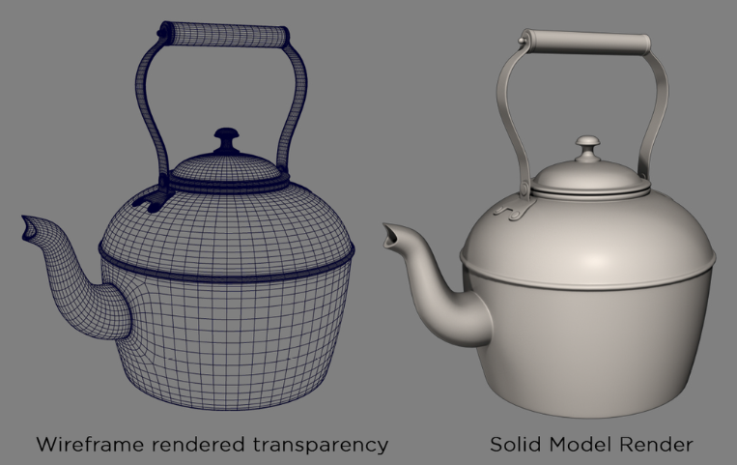
Objects represented with polygons
Polygons are typically triangles in a mesh. The more polygons the better the image and the slower the rendering
http://www.douk3d.com/wireframe-rendering

Slide 4
OpenGL
Open Graphics Language is now available in all browsers (and most phones and computers)
Allows simulated 3D scenes to be rendered very fast (millions of triangles per second)
The approach is to move the object representations into a circuit called a “Graphics Processing Unit” (GPU) which ahs specialized hardware to render the triangles.
This includes some complex math but there is help.
See Three.js examples

Slide 5
Ray Tracing
White Point Light
Red Light Reaches View
Blue Light Blocked
View (Camera)
Objects In a Scene

Slide 6

CanvasMap 3D
Developed to make it easy to put 3D Maps on the web
Based off of CanvasMap
Supports many Three.JS features inherently with the ability to extend to infinity and beyond!

Slide 7
New Stuff
OpenGL View: CM3View
Camera Controls in 3 Dimensions
Lights
Objects in 3 dimensions with:
  Textures
  Extrusions
  etc.

Slide 8
3 Dimensional Coordinates
3D Adds a “z” coordinate
Can be in the spatial data or as a setting
3D Objects can also have:
  Rotation: pitch, roll, and yaw
  Scaling factors
  We do not typically use these for spatial data

Slide 9
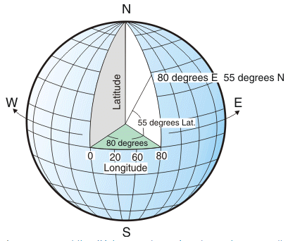
Spherical Coordinates
https://annakrystalli.me/intro-r-gis/gis.html

Slide 10
In “Flat” 3D
Z
Elevation
Elevation
Y
Latitude
Northing
X
Longitude
Easting
Note: It is traditional in 3D graphics to have y be up-down and z be in and out of the veiw

